Slide 1



TouchDesigner Workshop Sensors and OSC
20-4-2024 Creative Coding Utrecht
by Digital Piglet (Raul Leal)

Slide 2
Hi my name
is Raul Leal

Slide 3

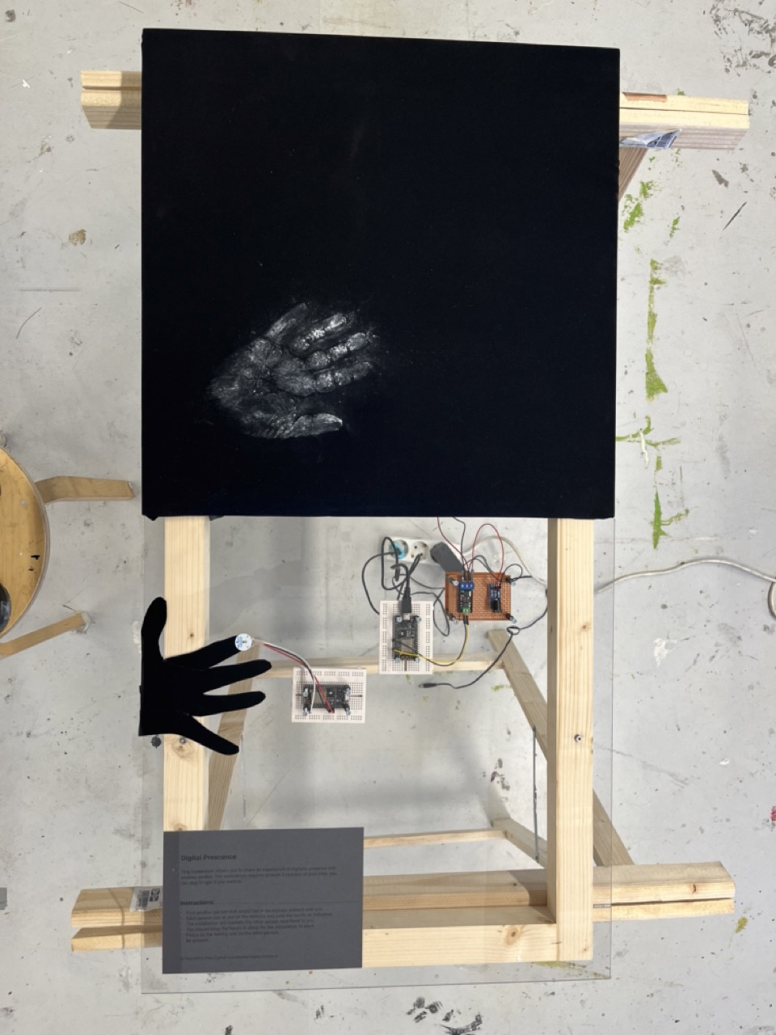
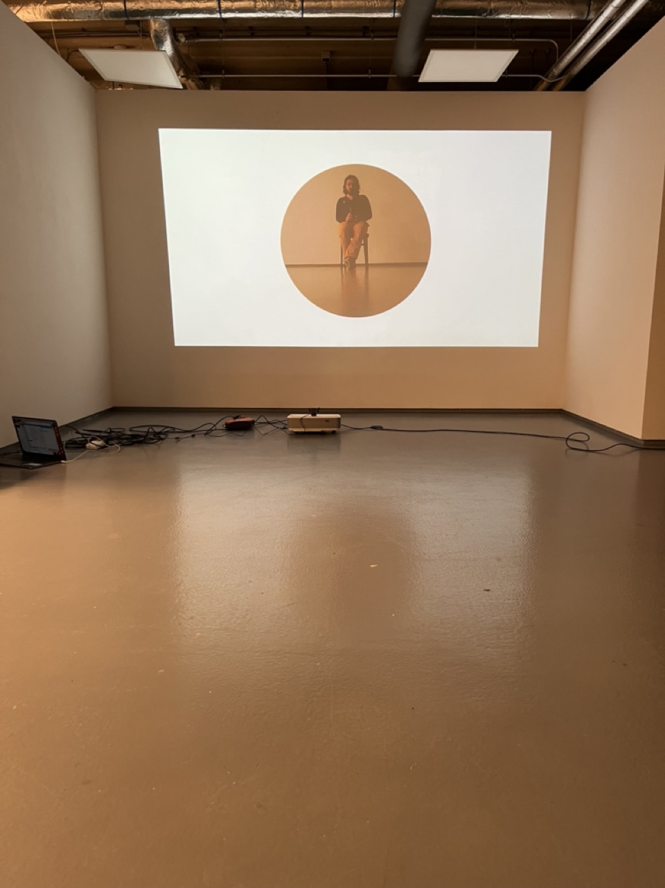
Me
Creative technologist
Rietveld – DogTime Unestable Media
In my practice I aim to use technology as companion for creation instead of simply as a tool

Slide 4
This workshop
What will do
What we will not do
Basic Introduction
Connecting things to TouchDesigner
Common patterns to process data
Assigning references
Interactive Bauhaus motion graphics
Get physical and have fun
No 3D
No Particles
No Kinect

Slide 5
Constrains for the workshops…
It is done in
TochDesigner and...
Only uses...
Only uses...
It is an intractive 2d animation,
i.e no 3d scenes, objects etc..

Slide 6

The workshop structure
Intro
Arduino with a cable
OSC Basic Communication
Touch OSC
More play:
Body tracking
Facial recognition
Multiple screens
ESP8266

Slide 7
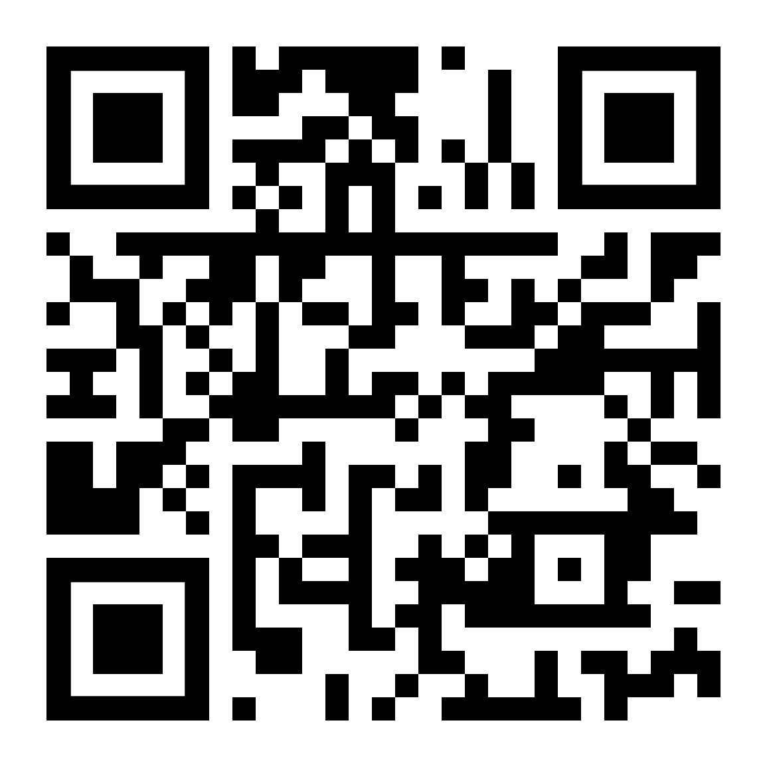
Practial Info
WIFI: ccu
WW: Code03084
https://discord.gg/dWyuS96jD6

Slide 8
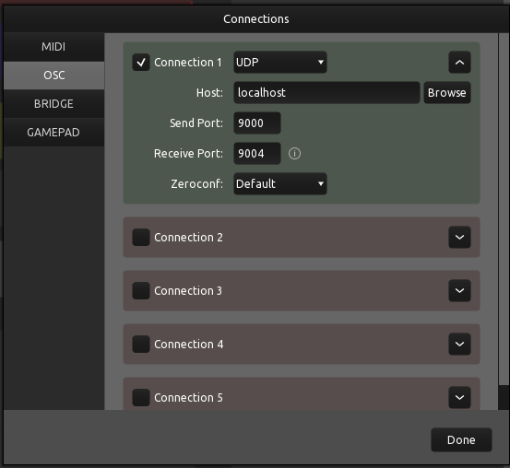
OSC

Slide 9
ESP8266 Installation
Follow installation instructions here https://randomnerdtutorials.com/how-to-install-esp8266-board-arduino-ide/
If you can not find the port install the usb drivers alsohttps://randomnerdtutorials.com/install-esp32-esp8266-usb-drivers-cp210x-windows/

Slide 10
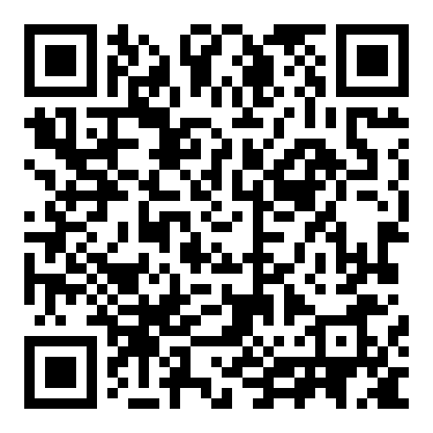
Git repository for these workshops
https://github.com/Rauleal/TouchDesigner_Bauhaus_workshop

Slide 11
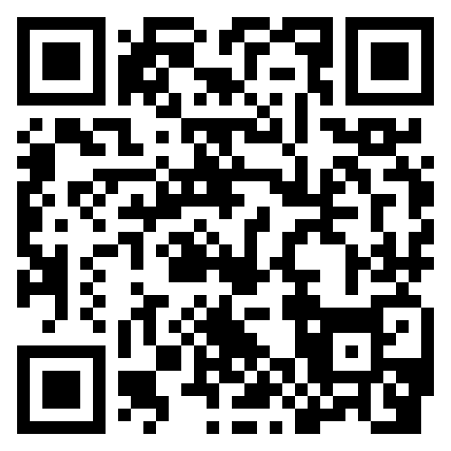
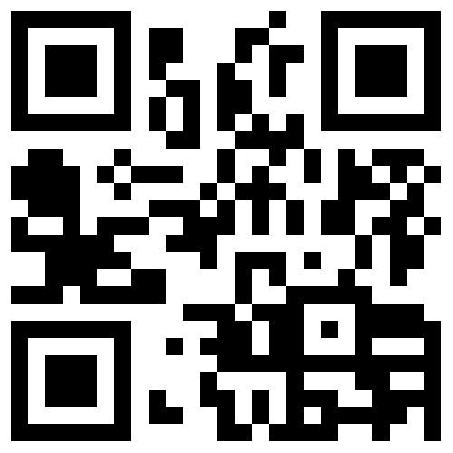
Email_to: raul.andres.leal@gmail.com
https://www.instagram.com/raul.andres.leal/
https://rauleal.com/

Slide 12
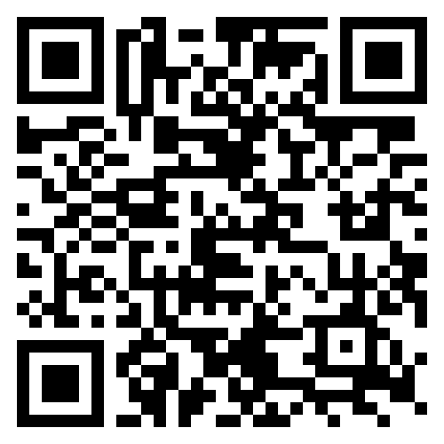
TouchDesigner Documentation
https://docs.derivative.ca/Main_Page

Slide 13
Coming up
25th TouchDesigner meetup

